Slide 1
Asteroseismology Group Studies
Professor Bill Chaplin, Dr Warrick Ball, Dr Martin Nielsen

Slide 2
ESA PLATO Mission (2026)
Goals of the mission:
exoplanet detection
characterisation of host stars (asteroseismology)
Opportunities:
find limitations of asteroseismic detections in K&M-type stars with PLATO
Credit: OHB System

Slide 3
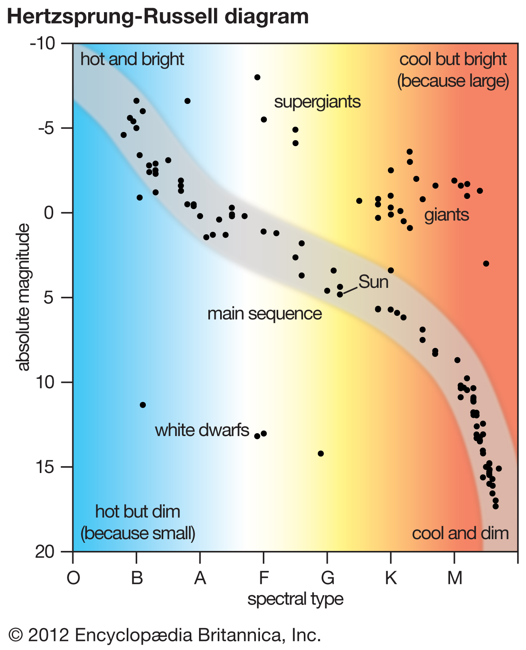
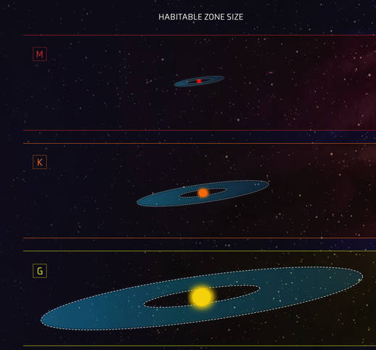
Motivations: K and M dwarfs
Credit: NASA, ESA, and Z. Levy (STScI)
Notes:
→ Hard to find oscillations for stars which are less massive than the Sun as they are generally cooler and dimmer but do get some oscillations for K dwarfs
→ can we detect oscillations in these types of stars (K and early M dwarfs) with Plato?
Focus on late K and M main sequence stars ⟶ smaller and cooler than the Sun
Red dwarfs present an interest as star hosts for exoplanets due to their abundance in the Milky Way.

Slide 4
Target Selection & Modelling

Slide 5
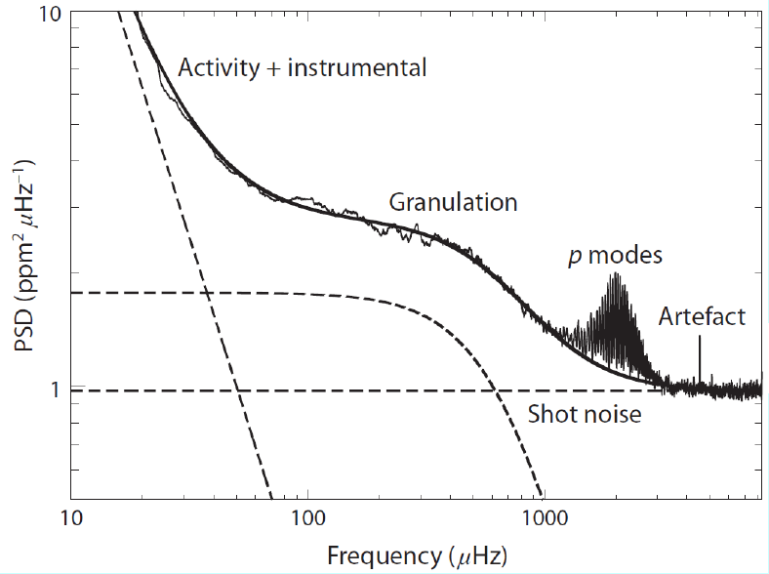
Goal: Modelling PSDs for K and M dwarfs
Credit: William J. Chaplin
Notes:
TSM goals:
select relevant stars from the TRILEGAL simulated galaxy to create a representation of what PLATO will observe
Make spectra for M and K dwarfs by extrapolating scaling relations derived for solar like stars based on Kepler results

Slide 6
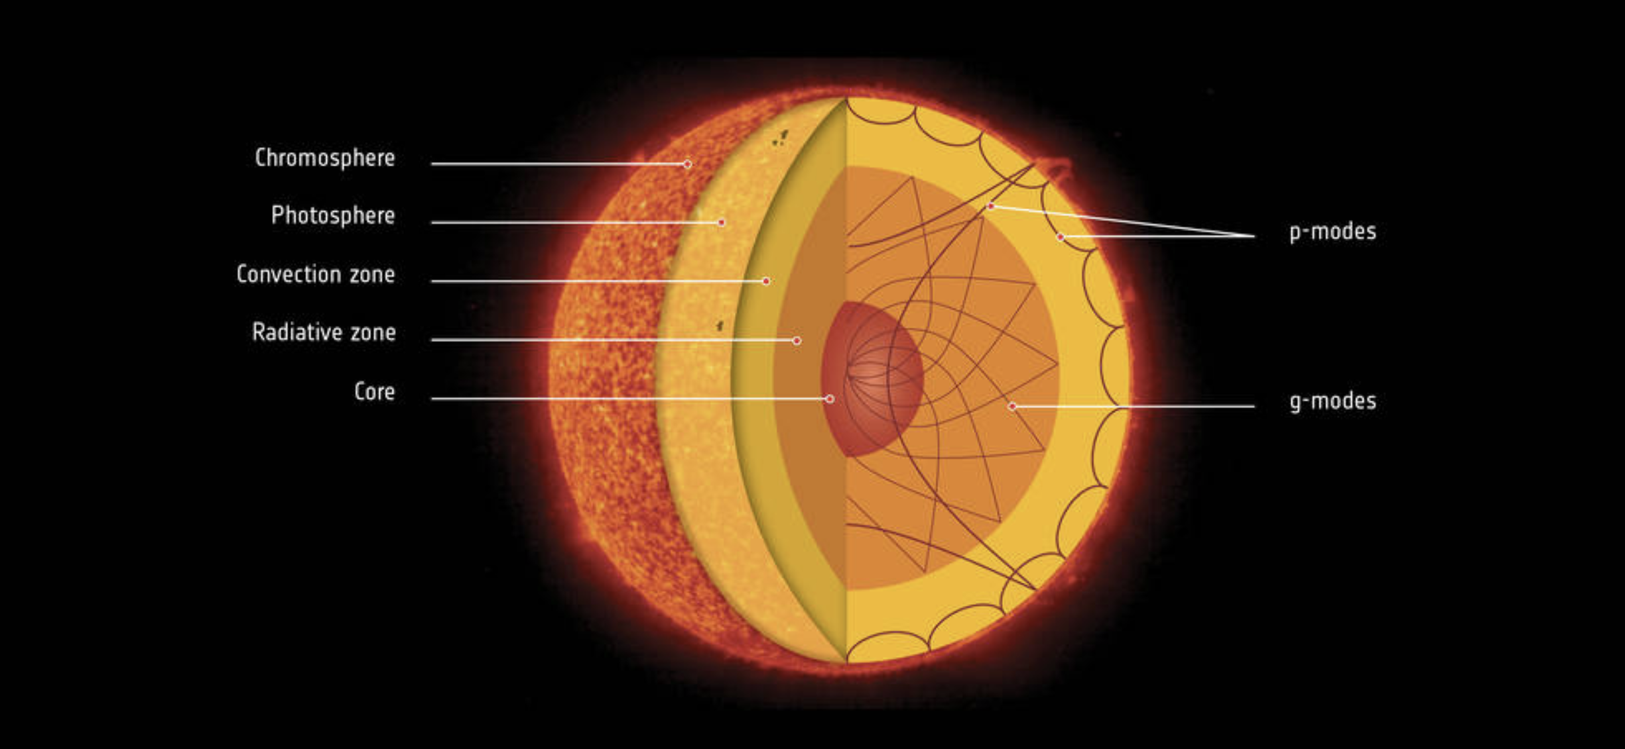
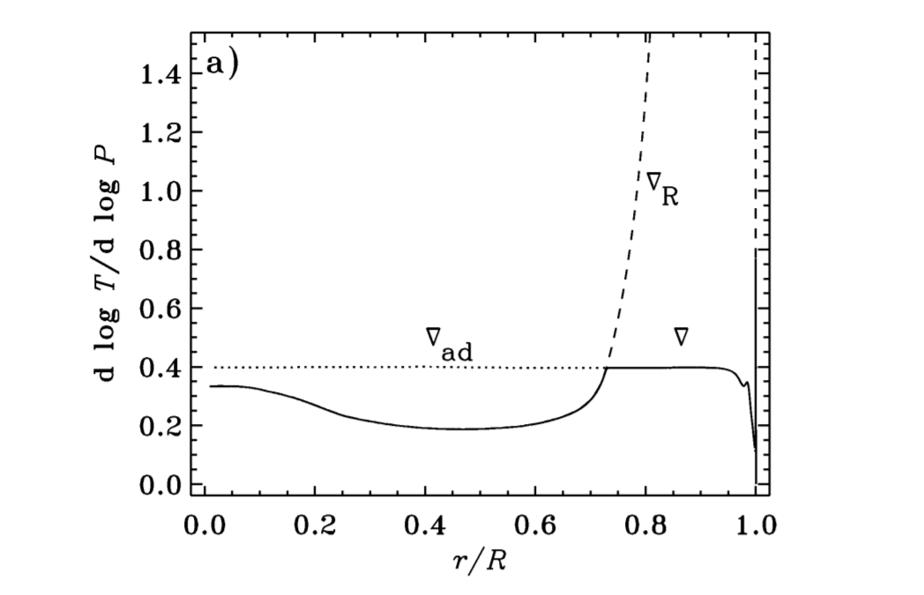
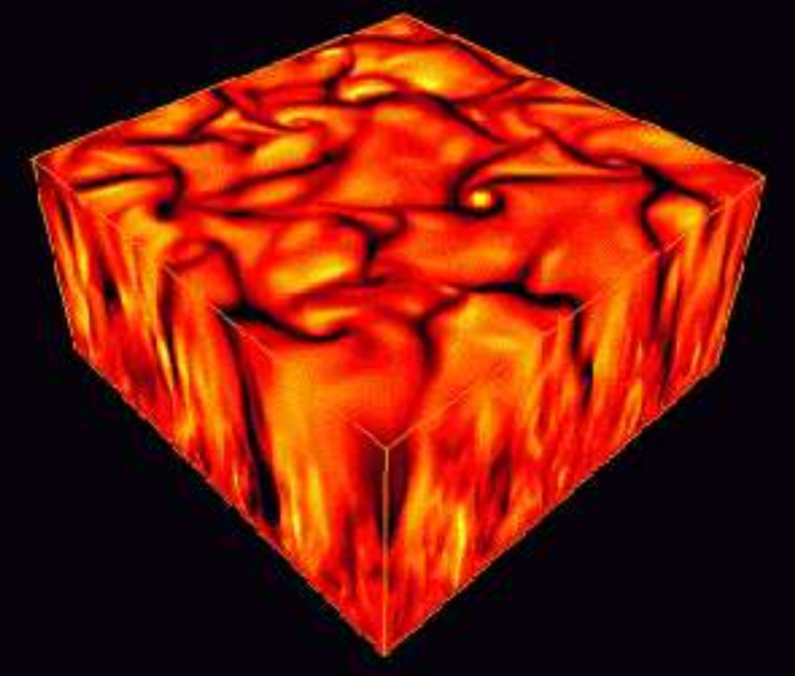
Stellar Oscillations
Credit: NASA
Stellar Structure and Evolution, JCD
Credit: NASA
Notes:
Granulation: The inner structure of a star is governed by hydrostatic equilibrium and must be satisfied in all regions of the star, despite what form of energy transport is taking place. One type of transport is convection where a displaced bubble of hot gas will rise and continue to do so if it remains hotter, and therefore less dense than the surrounding gas as a result of buoyant forces. The Schwarzschild Criterion formulates this by comparing the adiabatic temperature gradient to the ambient temperature gradient. Both fall towards the surface of the star, however, if the ambient temperature gradient falls quicker, a rising bubble will not lose energy fast enough to equilibrate with its surrounding and will therefore always remain hotter. The ambient temperature gradient can be approximated as the radiative temperature gradient and therefore by taking the modulus of these gradients, we find that convectively unstable regions exist where nabla_R>nabla_ad. This is satisfied when the opacity is large (at the surface of cooler stars), when rho/T^3 is large, again in the outer region of cooler stars, or when nabla_ad is small which is satisfied in the ionisation region of hydrogen. These regions generally lie in the outer 30% of a star.
A rising bubble accelerates through the outer layers of the star like a water fountain gushing over. Once the bubble reaches the photosphere, it loses its energy efficiently via radiation, becomes denser and then sinks back down. This occurs through filamentary structures, resulting in the bottom left image. This type of granulation pattern can be expected from any star which has an outer convective region.

Slide 7
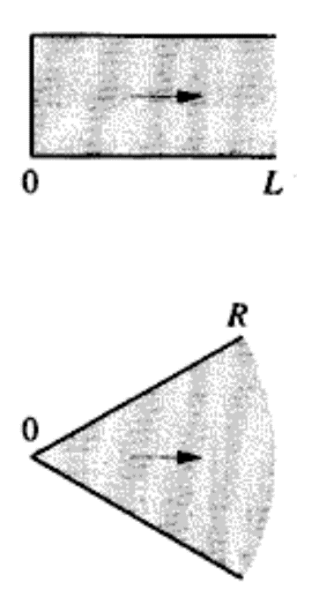
Stellar Oscillations
Credit: William J. Chaplin
Credit: Steven R. Majewski. University of Virginia.
Notes:
It The granulation acts as the excitation mechanism for resonant oscillations within the star. The star acts like spherical cavity which traps these waves, forming standing waves once they coalesce with their point of origin. Due to the inherently stochastic nature of the granulation, these waves are projected across varying angles to the surface where they proceed to be refracted towards regions of lower density (i.e. back towards the surface.) The effects of these waves on the shape of the star can be analysed by solving the spherical wave equation. The solutions are in the form of spherical harmonics where the modes have the typical, n,l and m numbers. n corresponds to the number of nodes in the standing wave which lie on the stellar radius, l refers to the number of nodes which lie on the stellar surface (l = 0 refers to a radial mode) and m refers to how many node planes bisect the equator. We are considering stars which don’t spin and therefore ignore m.
The star can be modelled as a pipe with one open end and where the other end dépends on the cut off frequency. Consequently, mode frequencies can be found as multiples of the fundamental frequency (n=0). The equation is given on the next slide.

Slide 8
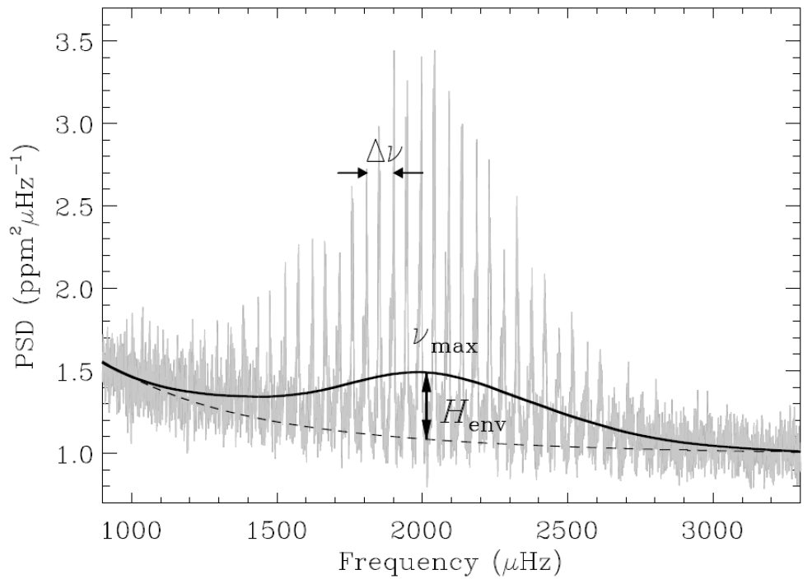
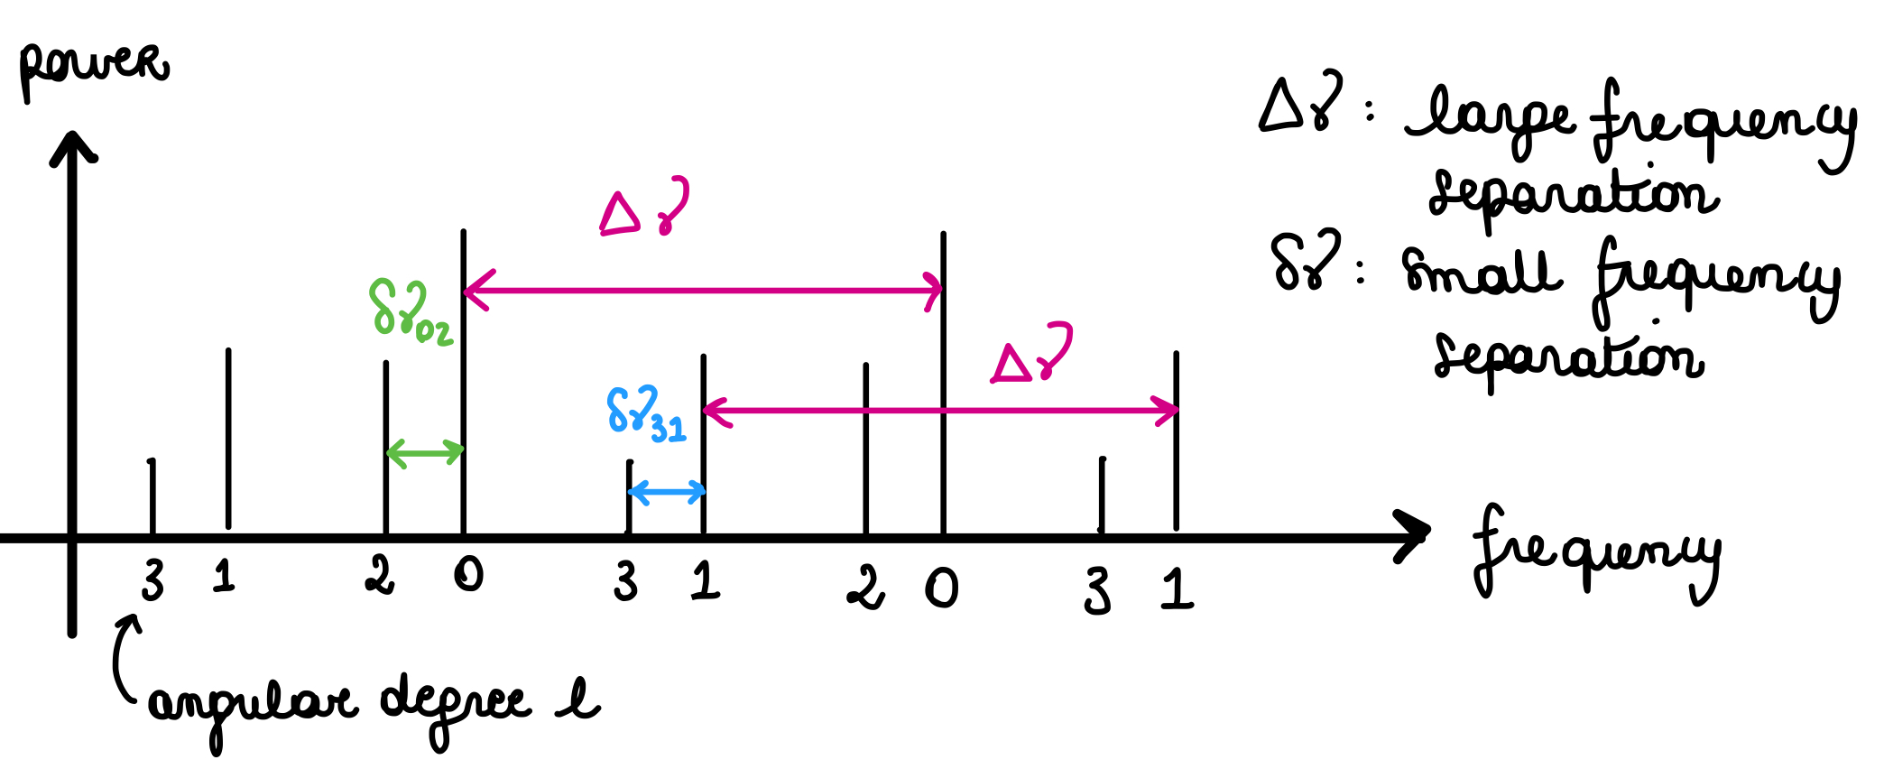
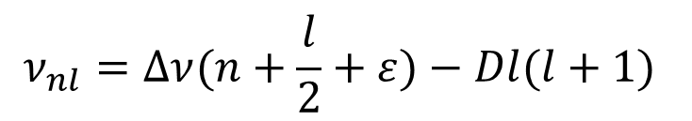
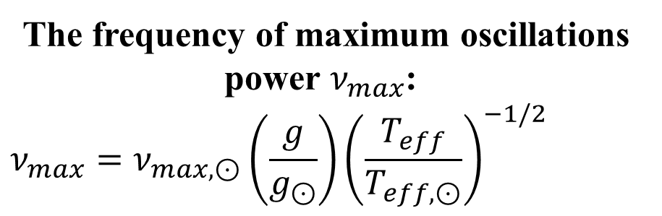
Oscillation modes
The frequency of maximum oscillations power $ν_{max}$ :
$$ν_{max}=ν_{max,⊙}\left(\frac{g}{g_{⊙}}\right){\left(\frac{T_{eff}}{T_{eff,⊙}}\right)}^{−1/2}$$
$$ν_{nl}=Δν(n+\frac{l}{2}+ε)−Dl(l+1)$$
Gaussian like envelope of power due to the p mode oscillations
Credit: William J. Chaplin
Notes:
The amplitude has its shape as in the figure due of the effects of beats: not just one single component but many different overlayed overtones due to different types of oscillations
The oscillations are modulated in power following a Gaussian like envelope:
→ frequency at max. amplitude is $ν_{max}$
→ the spacing between consecutive overtones of modes of the same angular degree is $Δν_{nl}$
These carry information about the fundamental properties of the star.

Slide 9
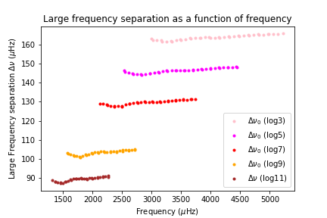
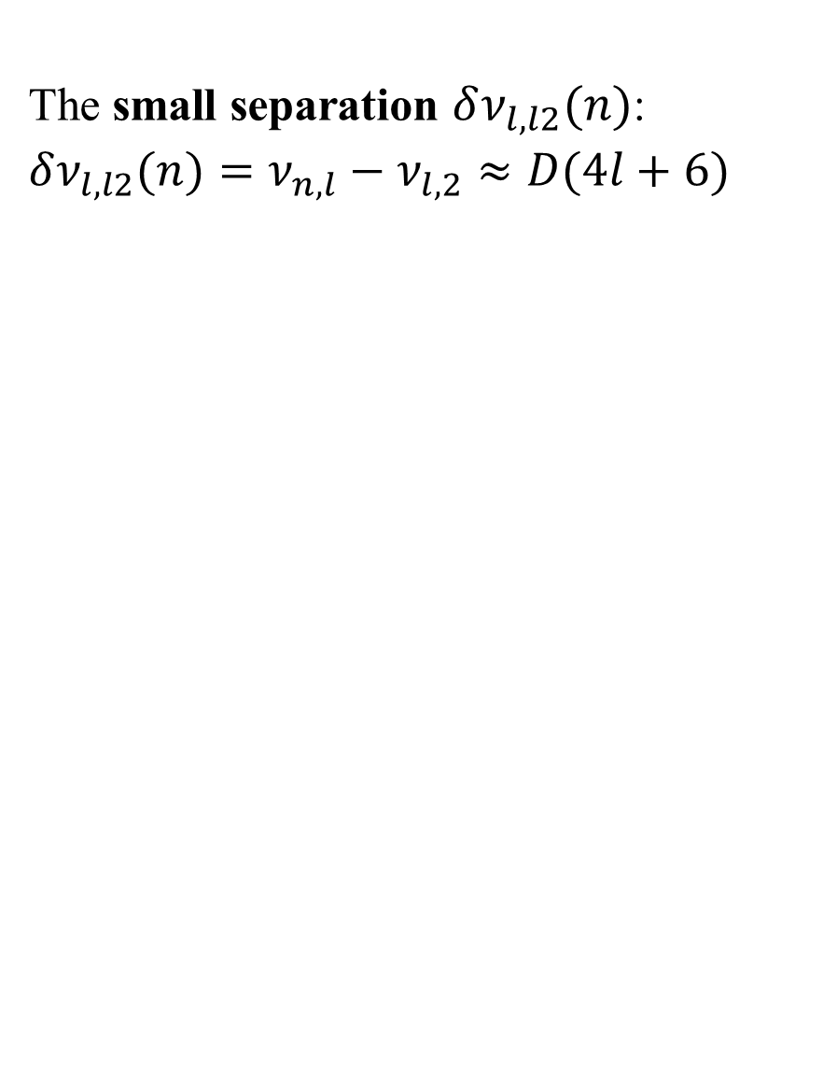
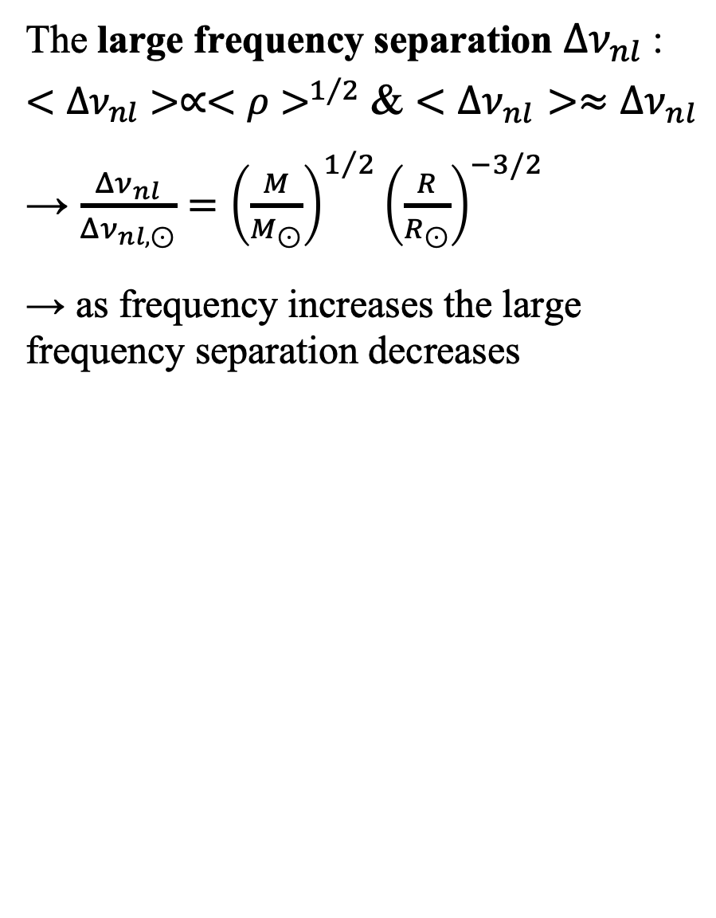
Oscillation modes
The small separation $δν_{l,l2}(n)$:
$$δν_{l,l2}(n)=ν_{n,l}−ν_{l,2}≈D(4l+6)$$
The large frequency separation $Δν_{nl}$ :$<Δν_{nl}>∝<ρ>^{1/2}$ & $<Δν_{nl}>≈Δν_{nl}$ → $\frac{Δν_{nl}}{Δν_{nl,⊙}}={\left(\frac{M}{M_{⊙}}\right)}^{1/2}{\left(\frac{R}{R_{⊙}}\right)}^{−3/2}$
→ as frequency increases the large frequency separation decreases
Notes:
$ν_{max}$ and $Δν_{nl}$ depend on stellar properties (cf. scaling relations)
⟶

Slide 10
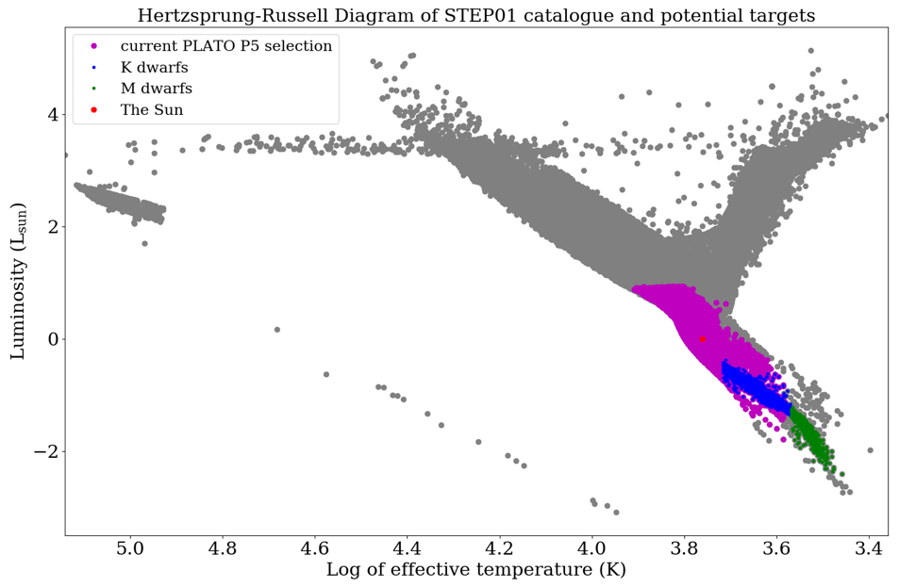
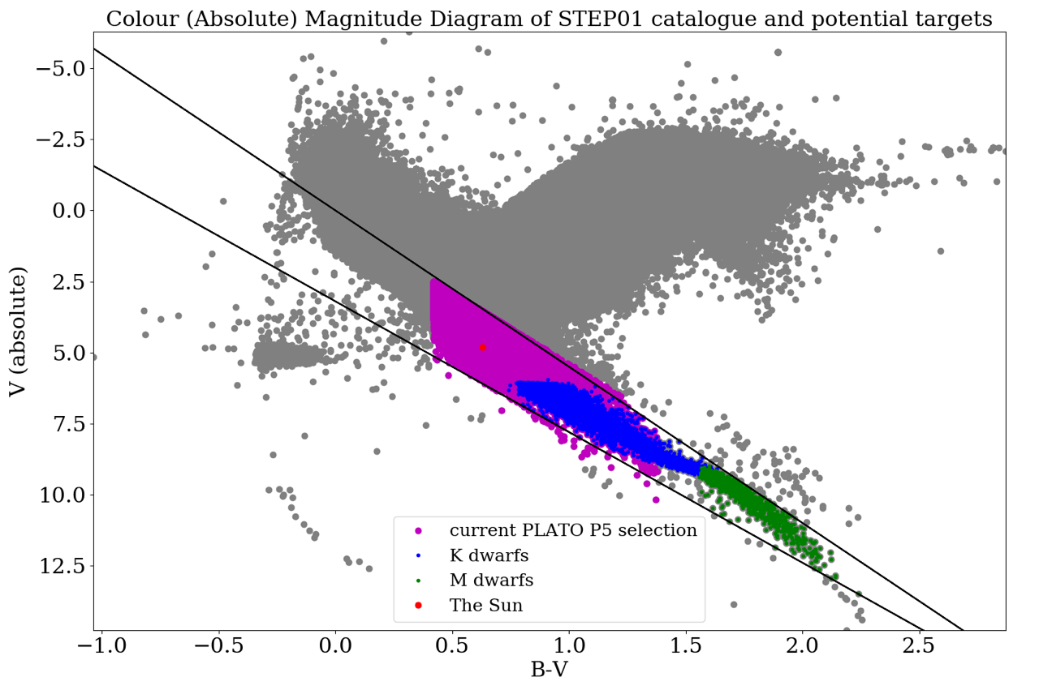
Target Selection: TRILEGAL
Total population (STEP01) = 1007115
Current PLATO (P5) selection population = 405587
K dwarf population = 20486
M dwarf population = 1128
Notes:
For current PLATO (P5) selection = 0.42 < B-V ≤1.38 and M_{v} ≥ 5(B-V)+0.4 AND M_{v} < 5(B-V)+3.5 ; Dwarf and subgiants F5-K7 Limiting V=13
For K dwarfs = 3700 K < Temperature < 5200 K, Luminosity < 0.6 L_{sun} , 0.5 M_{sun} < Mass < 0.8 M_{sun} and between the diagonal lines
For M dwarfs = 2400 K < Temperature < 3700 K, Luminosity < 0.08 L_{sun} , Mass < 0.6 M_{sun} and between the diagonal lines
As M and K dwarfs live the longest due to their low mass, they have the highest population, but because of the limiting magnitude of 13, they are generally too dim to observe oscillations.
This shows that we have worked upwards from brightest to dimmer stars to include.

Slide 11
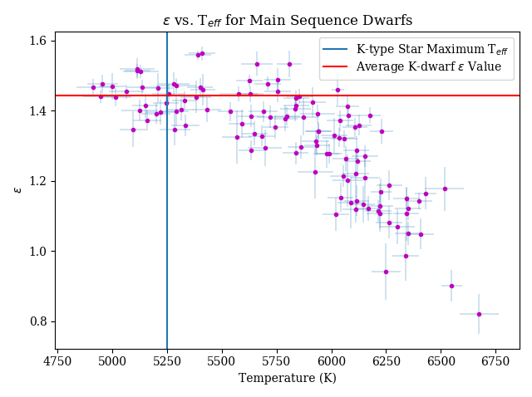
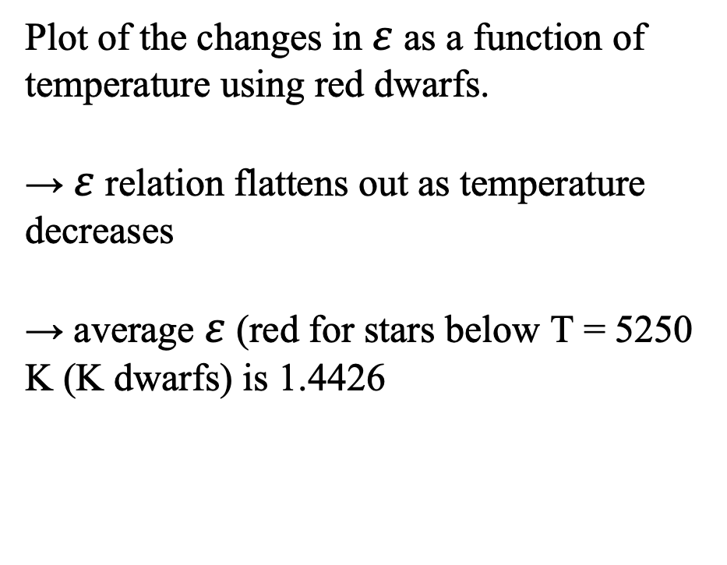
Oscillation modes
Plot of the changes in $ε$ as a function of temperature using red dwarfs.
→ $ε$ relation flattens out as temperature decreases
→ average $ε$ (red for stars below T = 5250 K (K dwarfs) is 1.4426
Notes:
The trend shows that with decreasing temp. epsilon flattens to a more constant value. This is seen (more clearly) in ε-diagrams from White 2012 in the report, which show how, for growing Δ𝜈, isochrone tracks of epsilon flatten out.
(Increasing Δ𝜈 is equivalent to decreasing T for MS stars as both relate to root of mean density.)
Therefore we used a constant value for epsilon, ε = 1.4426, by taking the average of epsilon values for all stars below T=5250K (~where brightest K dwarfs begin, accounting for uncertainty). Blue line is temperature cutoff, red line is the average we took.

Slide 12
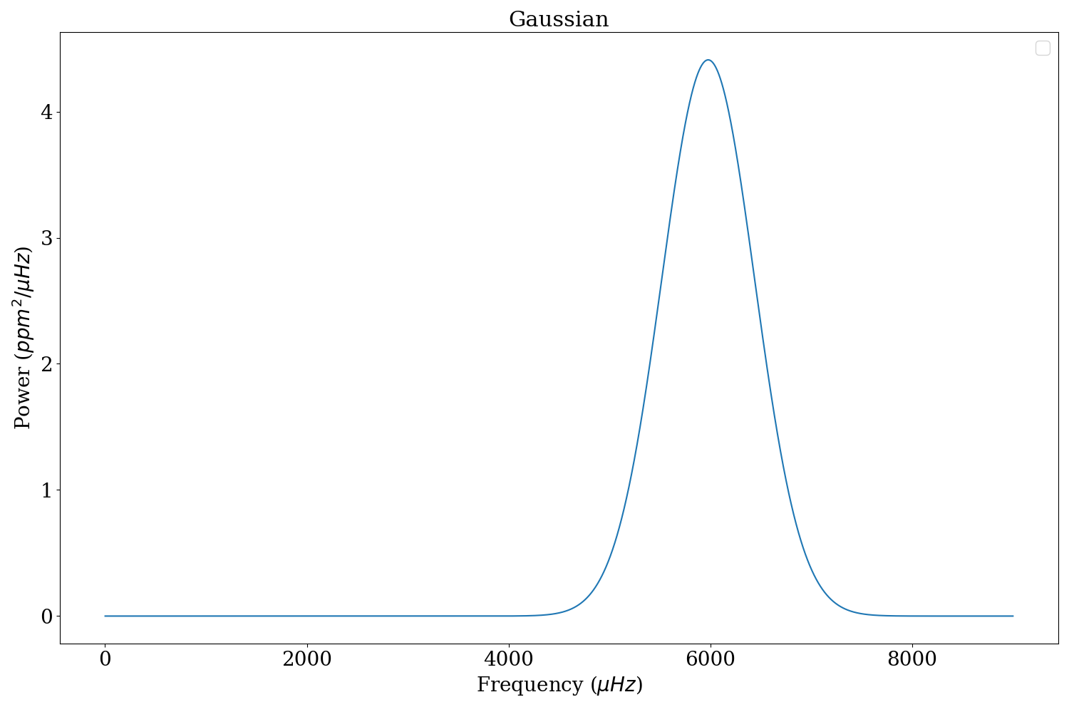
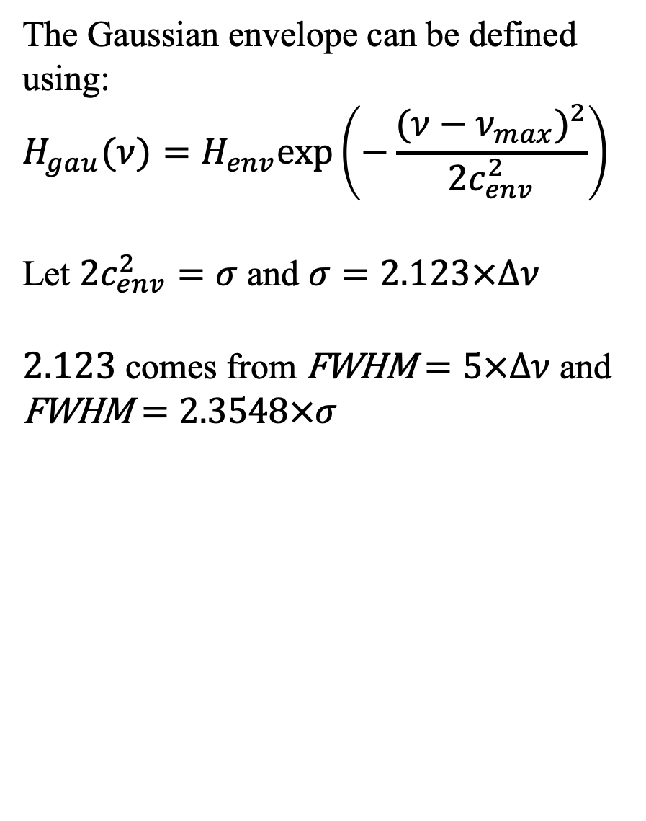
The Gaussian envelope
The Gaussian envelope can be defined using:
$$H_{gau}(ν)=H_{env}exp\left(−\frac{(ν−ν_{max})^{2}}{2c_{env}^{2}}\right)$$
Let $2c_{env}^{2}=σ$ and $σ=2.123×Δν$
$2.123$ comes from $\text{FWHM}=5×Δν$ and $\text{FWHM}=2.3548×σ$
Notes:
From this slide we are showing step by step how we constructed the spectrum by adding all these components together.

Slide 13
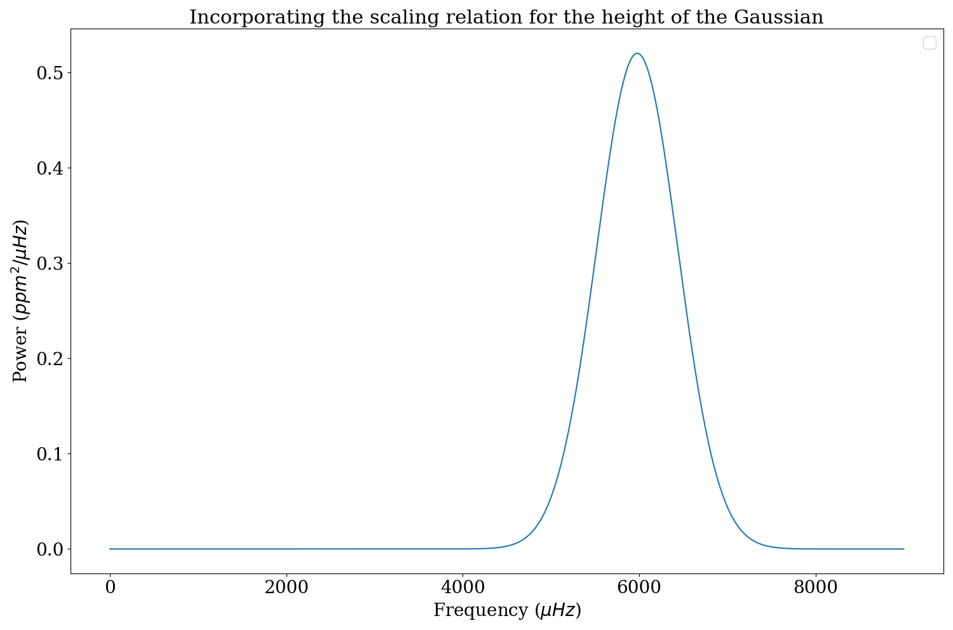
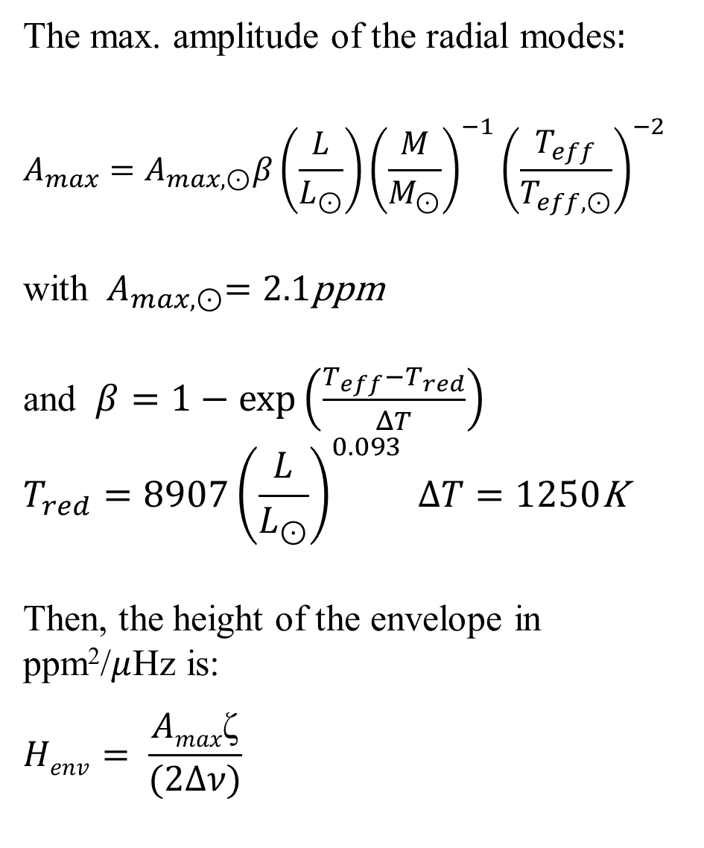
The Lorentzian Peaks
The max. amplitude of the radial modes$:$
$$A_{max}=A_{max,⊙}β\left(\frac{L}{L_{⊙}}\right){\left(\frac{M}{M_{⊙}}\right)}^{−1}{\left(\frac{T_{eff}}{T_{eff,⊙}}\right)}^{−2}$$
with ${ A}_{max,⊙}=2.1\text{ppm}$
and $β=1−exp\left(\frac{T_{eff}−T_{red}}{ΔT}\right)$
$$T_{red}=8907{\left(\frac{L}{L_{⊙}}\right)}^{0.093} ΔT=1250\text{K}$$
Then, the height of the envelope in ppm²/$μ$Hz is:
$$Henv= \frac{Amax\text{ζ}}{(2Δν)}$$
Notes:
From “A synthetic sample of short-cadence solar-like oscillators for TESS”, Ball et al
The beta factor corrects for the apparent decrease in the amplitudes of the hottest dwarfs.

Slide 14
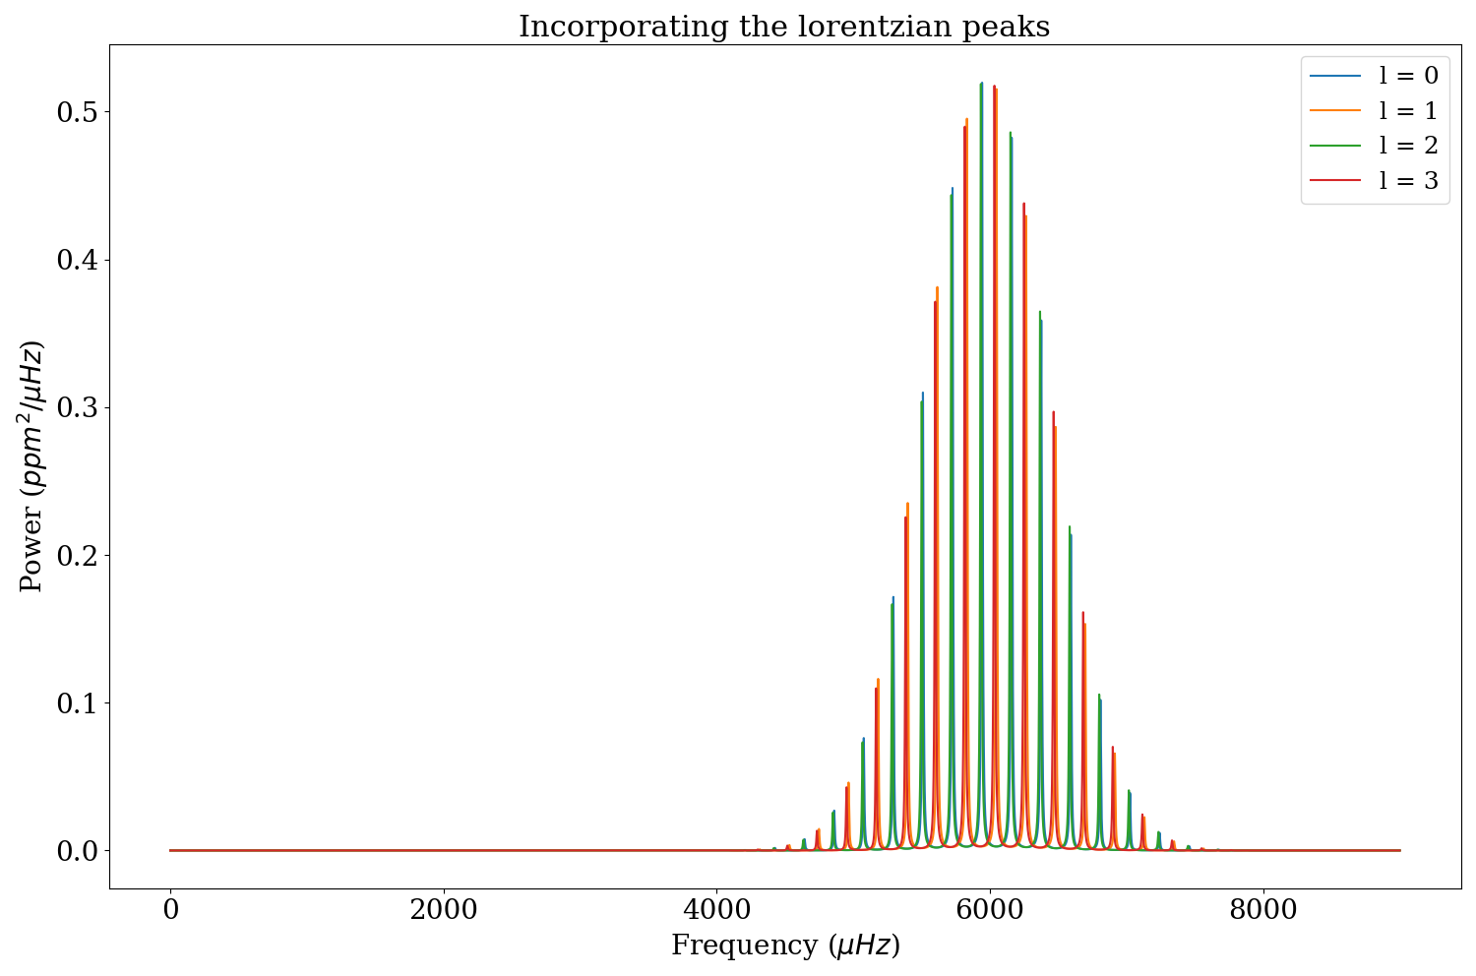
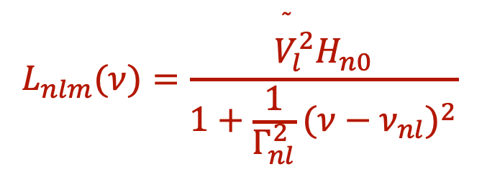
The Lorentzian Peaks
$$L_{nlm}(ν)=\frac{{\overset{˜}{V}}_{l}^{2}H_{n0}}{1+\frac{1}{Γ_{nl}^{2}}(ν−ν_{nl})^{2}}$$
Notes:
Normally there are factors dependent on the stellar inclination angle and rotational splitting. Here we are treating the model as non rotating so these factors are ignored when building the spectra.

Slide 15
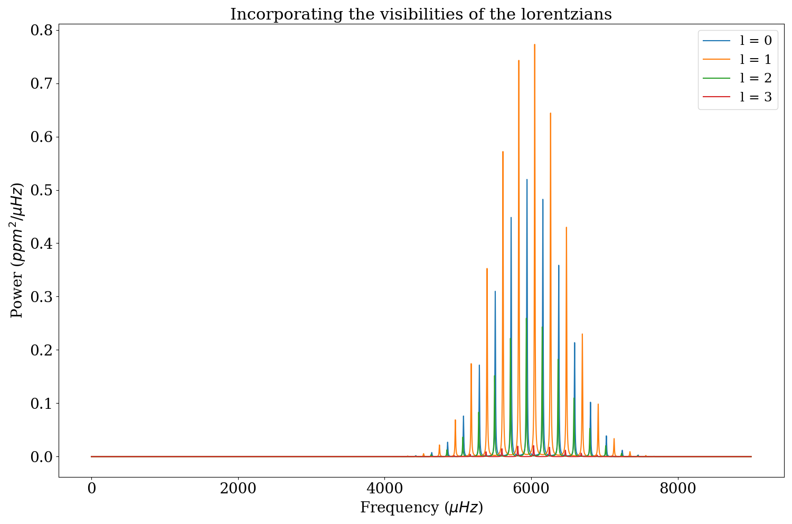
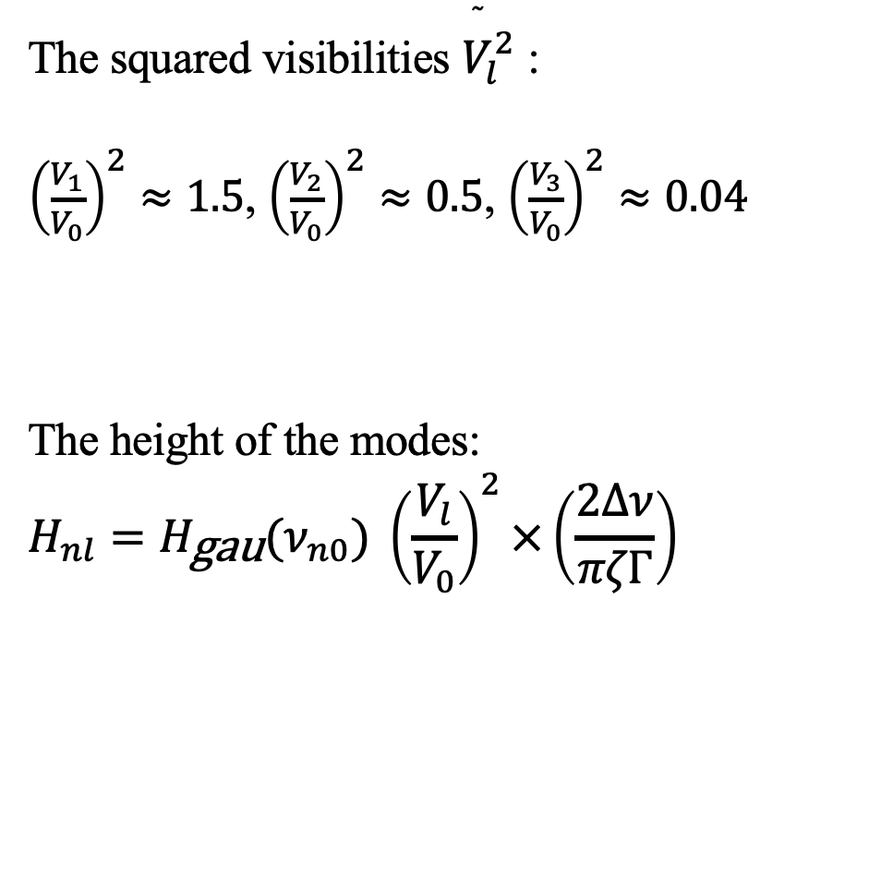
The Lorentzian Peaks
The squared visibilities ${\overset{˜}{V}}_{l}^{2}$ :
${\left(\frac{V_{1}}{V_{0}}\right)}^{2}≈1.5$, ${\left(\frac{V_{2}}{V_{0}}\right)}^{2}≈0.5$, ${\left(\frac{V_{3}}{V_{0}}\right)}^{2}≈0.04$
The height of the modes:
$$H_{nl}=H_{\text{gau}}(ν_{n0}) {\left(\frac{V_{l}}{V_{0}}\right)}^{2}×\left(\frac{2Δν}{πζΓ}\right)$$
Notes:
⟶ correction for the relative visibilities of different degrees l (1,2 and 3) because of geometric cancellation.
Here use the scaled visibilities with respect to those at l = °

Slide 16
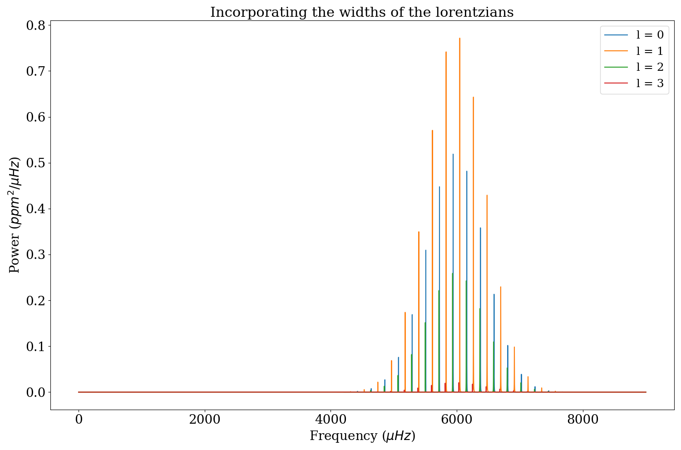
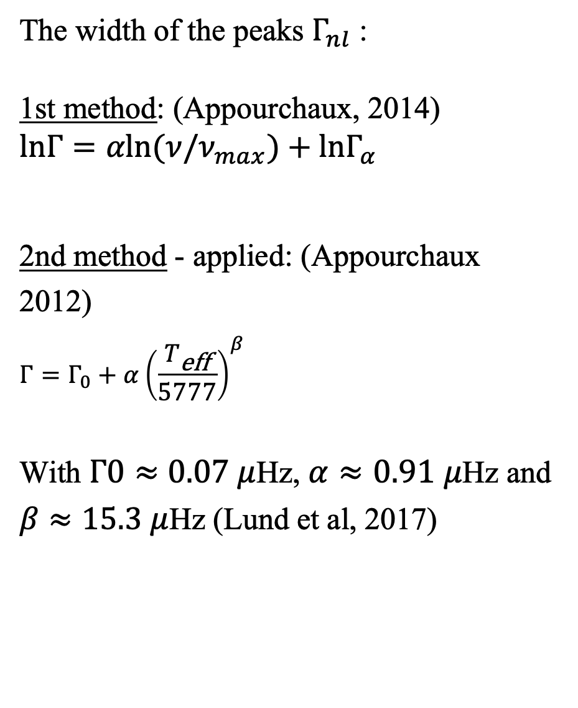
The Lorentzian Peaks
The width of the peaks $Γ_{nl}$ :
1st method: (Appourchaux, 2014)
$$lnΓ=αln(ν/ν_{max})+lnΓ_{α}$$
2nd method - applied: (Appourchaux 2012)
$$Γ=Γ_{0}+α{\left(\frac{T_{\text{eff}}}{5777}\right)}^{β}$$
With $Γ0≈0.07$ $μ$Hz, $α≈0.91$ $μ$Hz and $β≈15.3$ $μ$Hz (Lund et al, 2017)
Notes:
1st method:
In the original equation as introduced by Appourchaux et al in 2014, the first term is a power law of exponent alpha with gamma alpha the amplitude of the line width at nu max. The second part accounts for a Lorentzian dip.
In the case of K and M dwarfs, it wasn’t deemed necessary to consider the dip because it doesn’t seem to work for lower temperatures than solar-like stars. Unfortunately this seemed to overestimate the value of the linewidth
2nd method:
Focused on the value of the width at numax, based on the fitting parameters provided by Lund et al. This recovers the 1$μ$Hz value for the Sun. Then values of the linewidth for K dwarfs range between 0.249 - 0.07 $μ$Hz

Slide 17
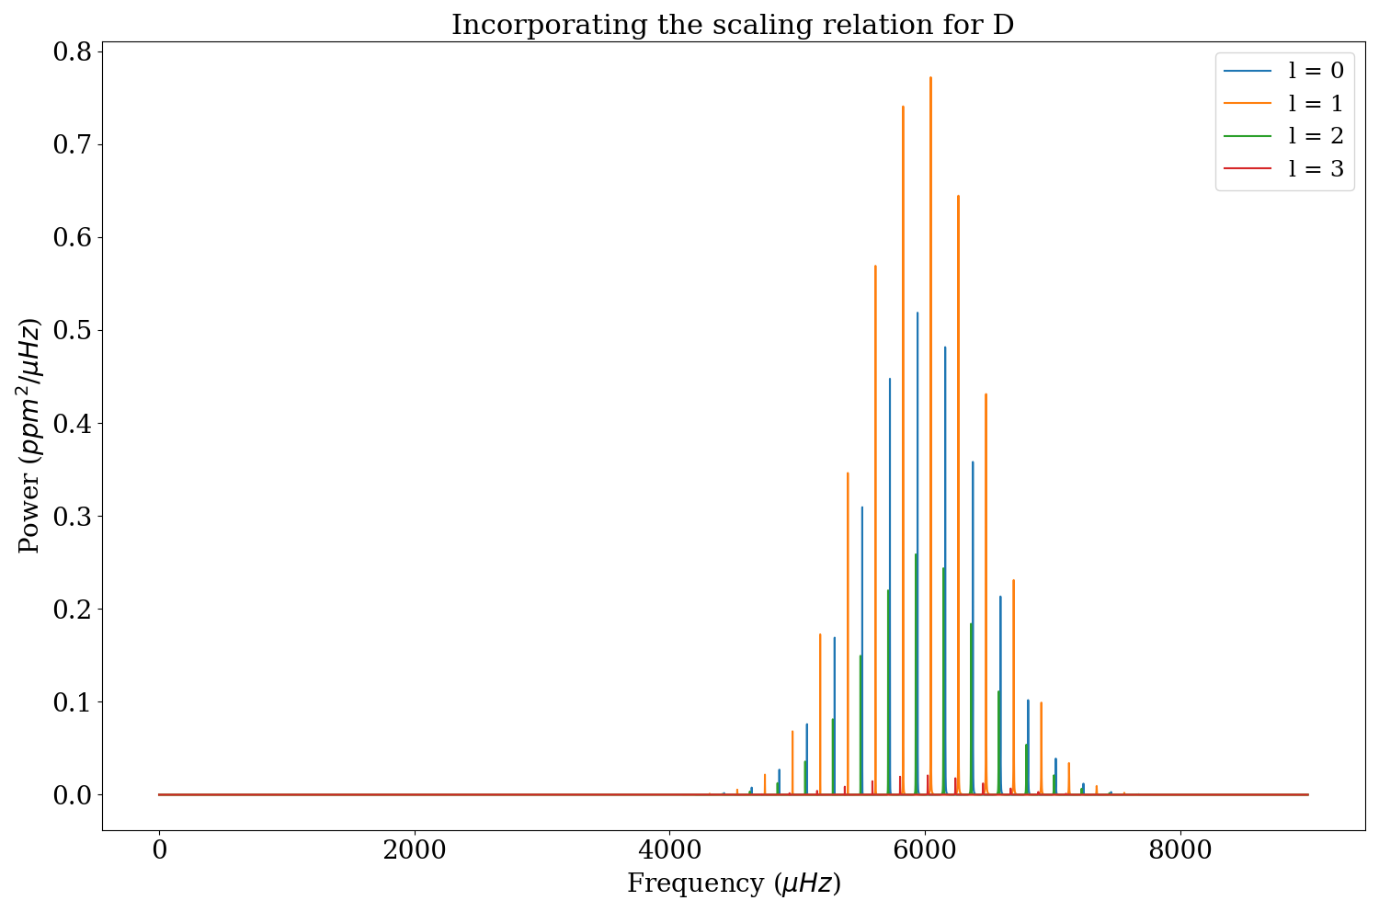
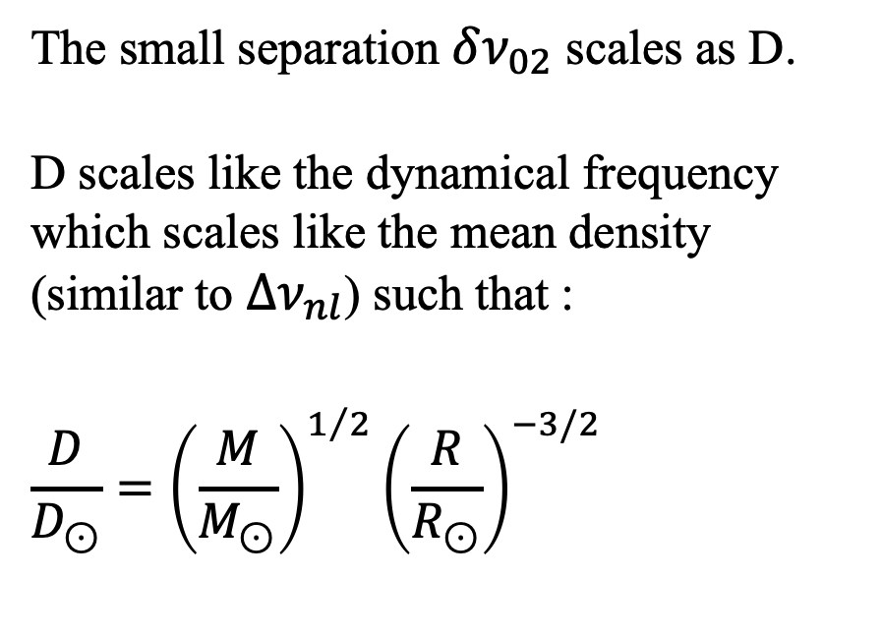
The Lorentzian Peaks
The small separation $δν_{02}$ scales as D.
D scales like the dynamical frequency which scales like the mean density (similar to $Δν_{nl}$) such that :
$$\frac{D}{D_{⊙}}={\left(\frac{M}{M_{⊙}}\right)}^{1/2}{\left(\frac{R}{R_{⊙}}\right)}^{−3/2}$$
Notes:
It was thought to define D as a function of temperature, age, metallicity, $ν_{max}$ and $Δν_{nl}$
⟶ gave bigger values than expected.
Since D is fixed by the change in properties with depth in the core regions it was thought to scale it instead like the dynamical frequency

Slide 18
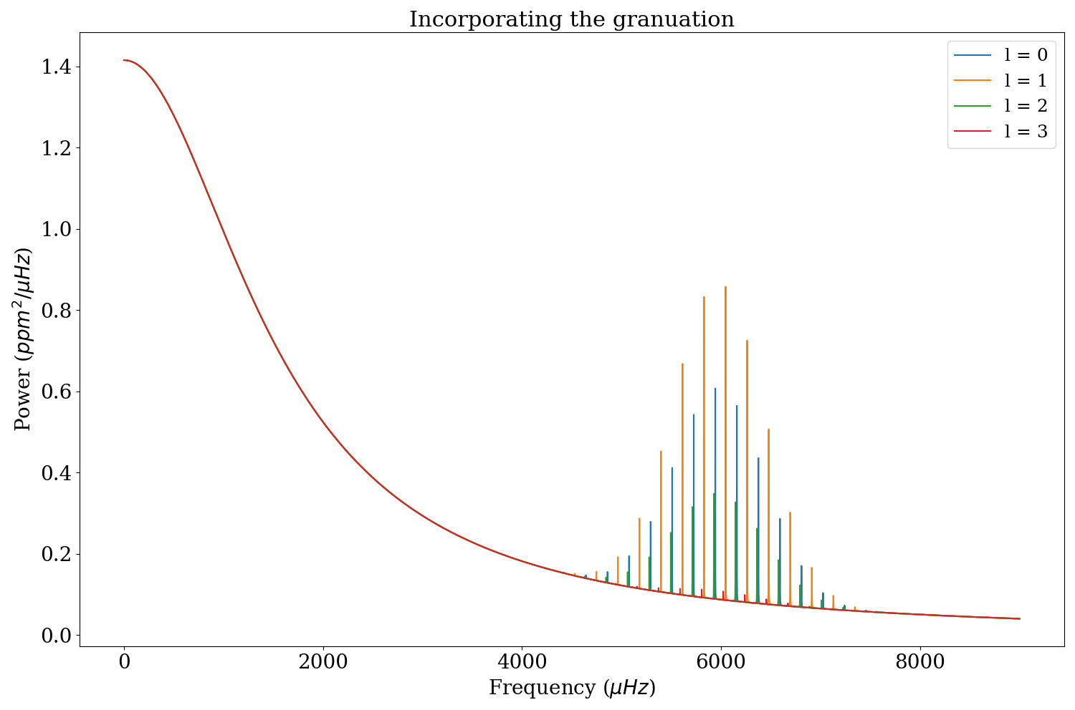
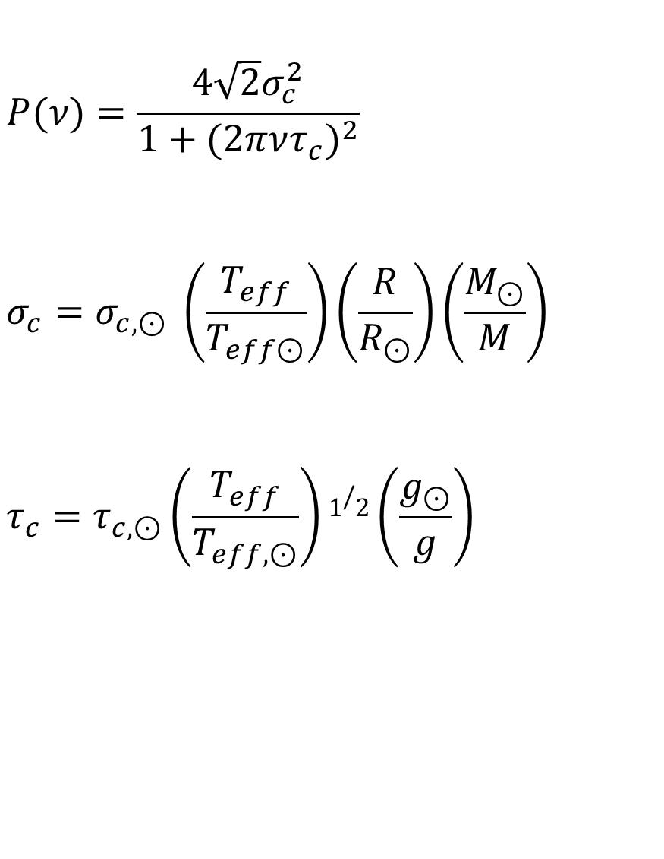
The Granulation
$$P(ν)=\frac{4\sqrt{2}σ_{c}^{2}}{1+(2πντ_{c})^{2}}$$
$$σ_{c}=σ_{c,⊙} \left(\frac{T_{eff}}{T_{eff⊙}}\right)\left(\frac{R}{R_{⊙}}\right)\left(\frac{M_{⊙}}{M}\right)$$
$$τ_{c}=τ_{c,⊙}\left(\frac{T_{eff}}{T_{eff,⊙}}\right)1/2\left(\frac{g_{⊙}}{g}\right)$$
Notes:
The granulation can be modelled as a zero-centred Lorentzian. The exponent “2” in the denominator of the power spectrum represents a model for a granule which is instantaneously excited to the rms brightness σ and then exponentially decays away with the typical convective timescale τ_c in the time domain. Arguments can be made to make this exponent 4 which would represent exponential excitation followed by subsequent exponential decay.

Slide 19
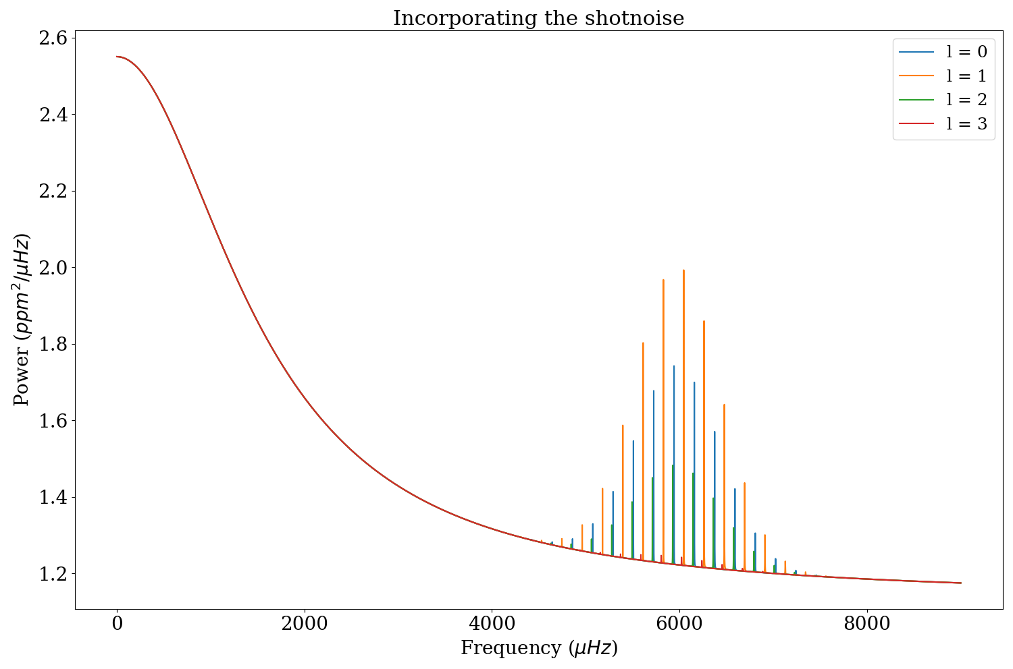
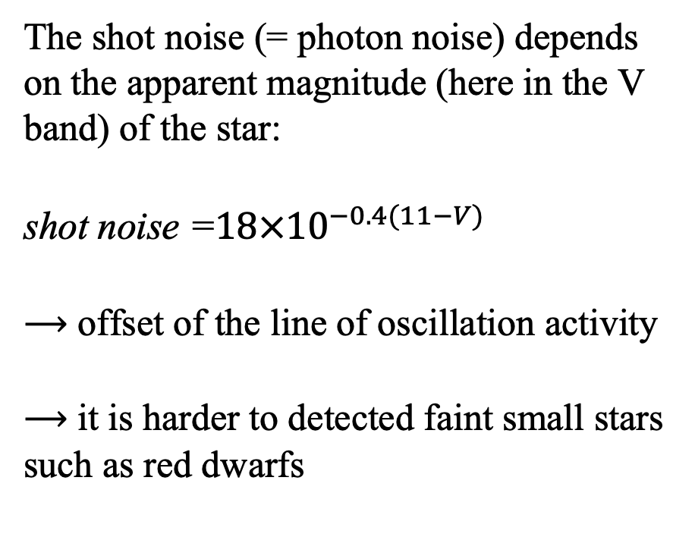
The Shot Noise
The shot noise (= photon noise) depends on the apparent magnitude (here in the V band) of the star:
$\text{shot} \text{noise} \text{=}18×{10}^{−0.4(11−V)}$
⟶ offset of the line of oscillation activity
⟶ it is harder to detected faint small stars such as red dwarfs

Slide 20
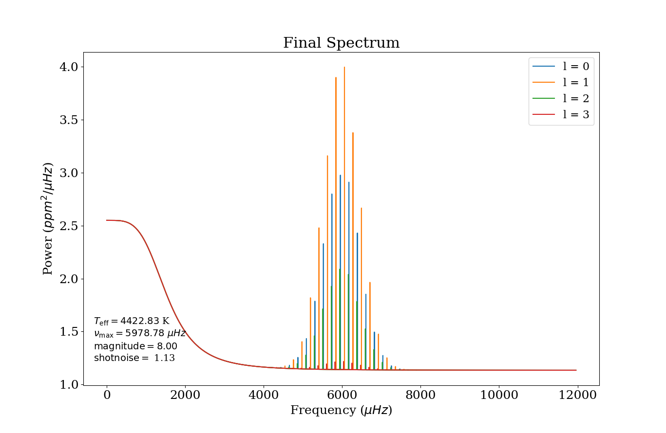
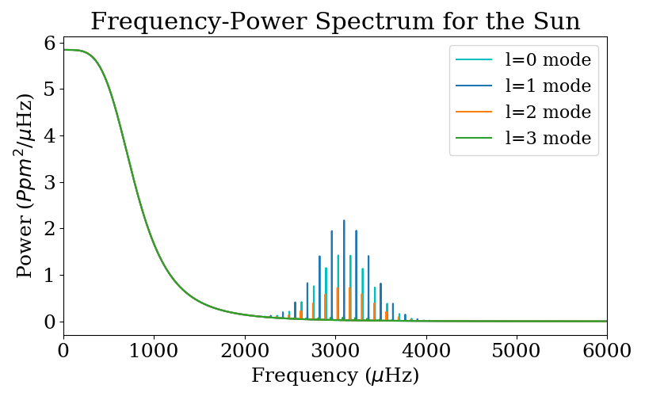
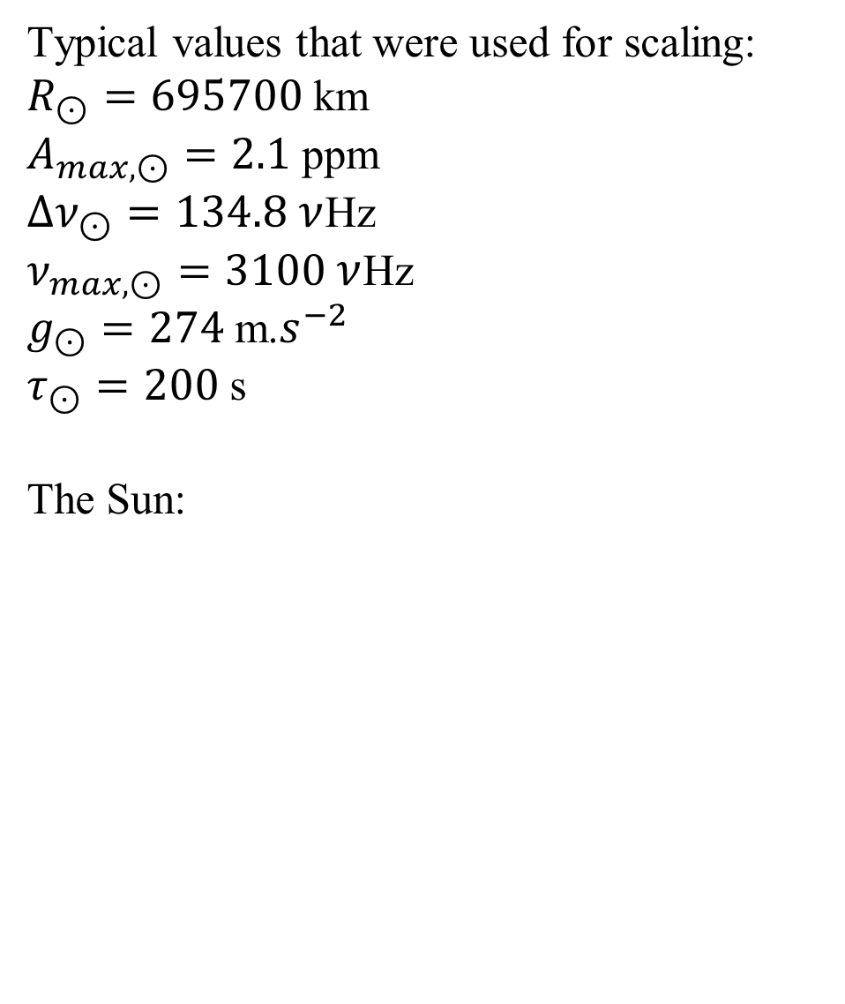
The Final Frequency-Power Spectrum
Typical values that were used for scaling:
$R_{⊙}=695700$ km
$A_{max,⊙}=2.1$ ppm
$Δν_{⊙}=134.8$ $ν$Hz
$ν_{max,⊙}=3100$ $ν$Hz
$g_{⊙}=274$ m.$s^{−2}$
$τ_{⊙}=200$ s
The Sun:

Slide 21
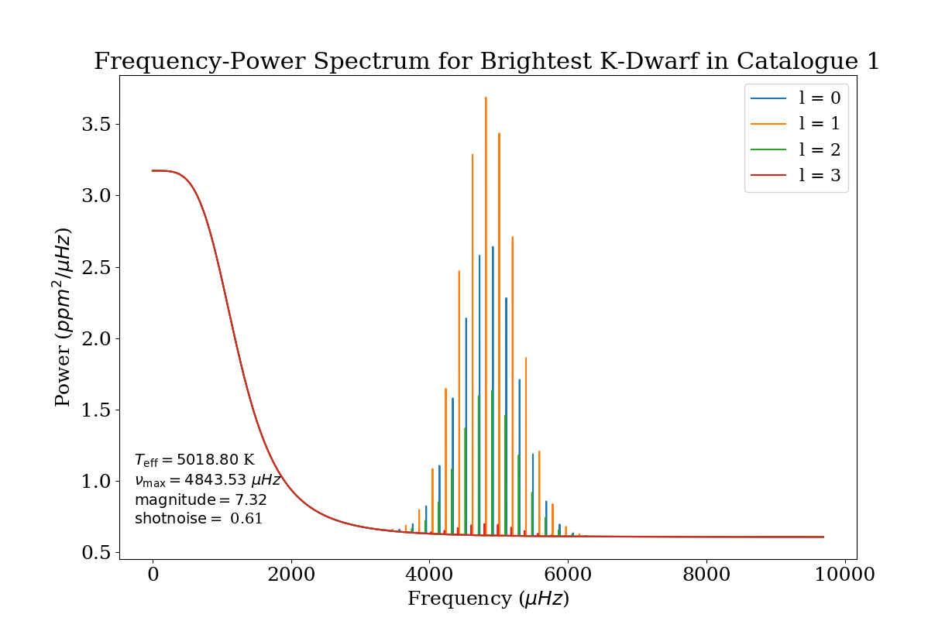
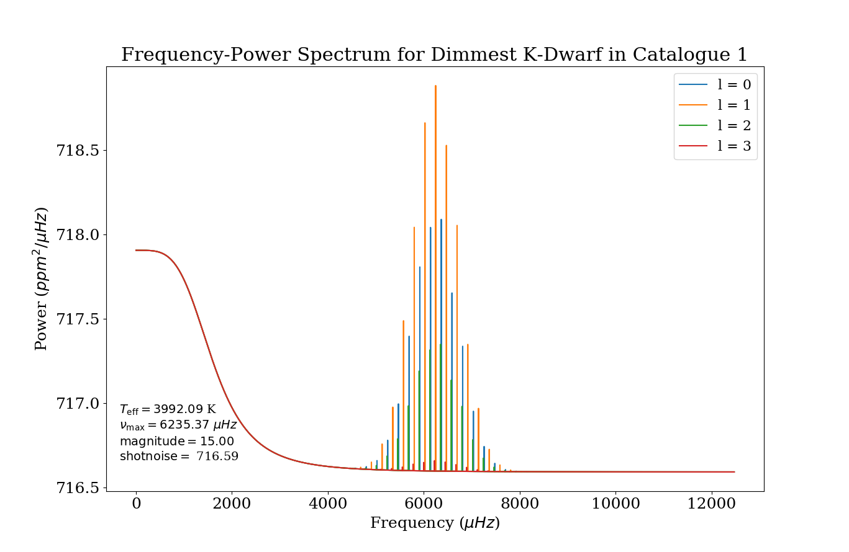
Results - K Dwarfs
→ The dimmer star has a much greater shot noise
→ The spectra have the same form but for detectability, the dimmer stars are much harder to resolve in power

Slide 22
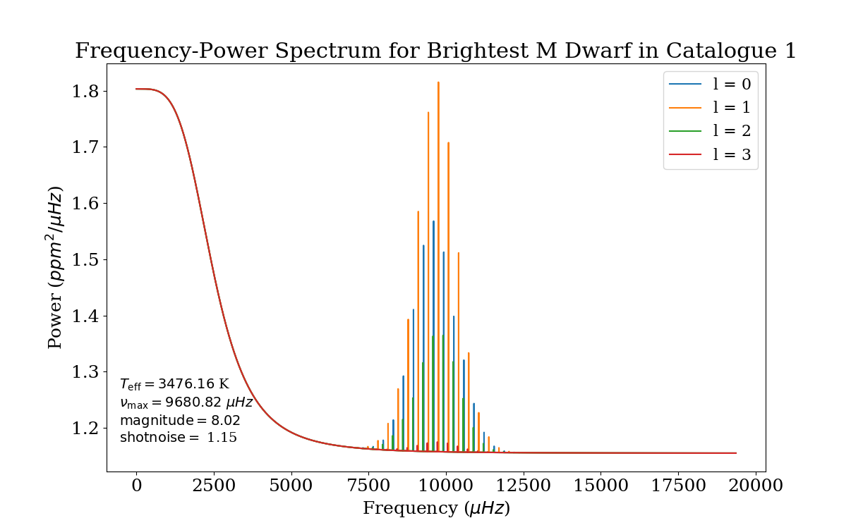
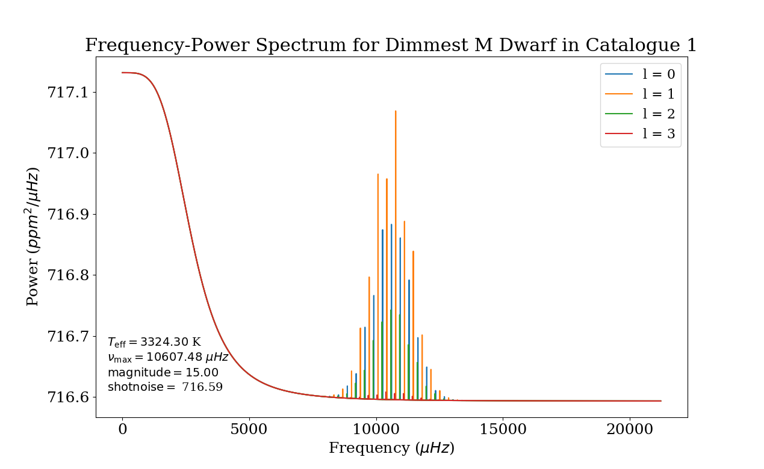
Results - M Dwarfs
→ The amplitudes of the oscillation modes are much smaller for M dwarfs than for K dwarfs and hence harder to detect above shot noise

Slide 23
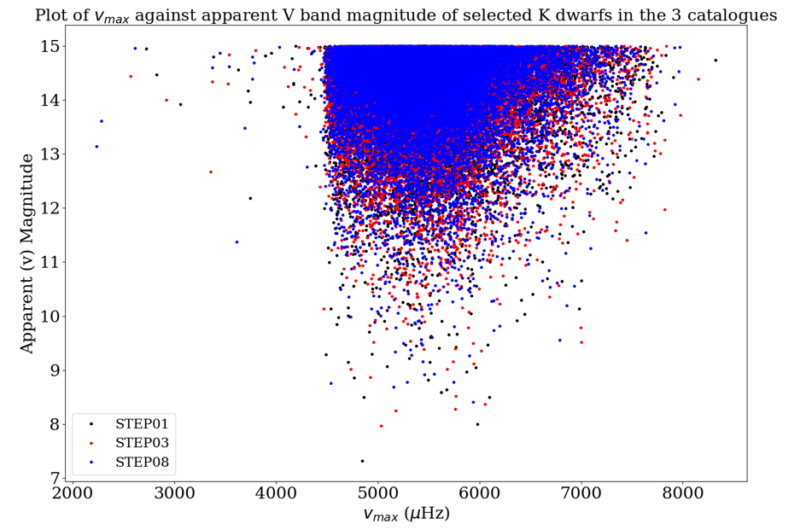
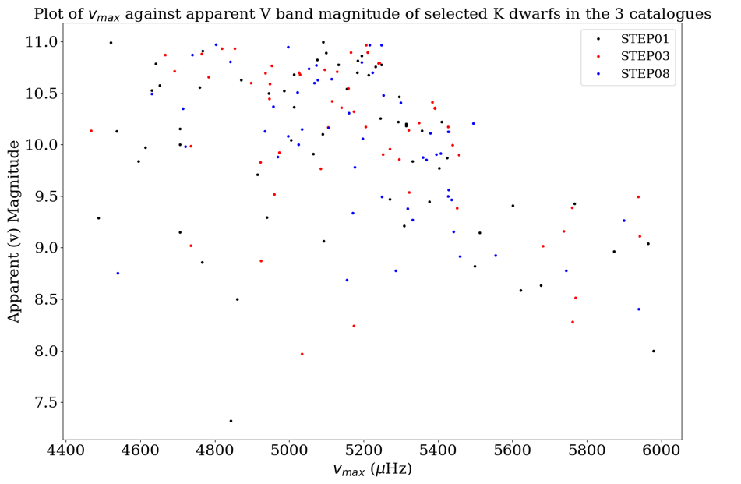
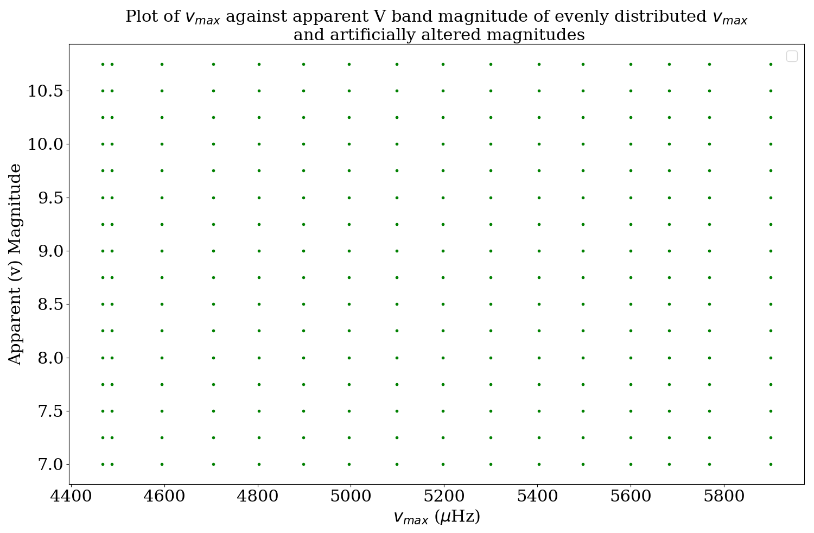
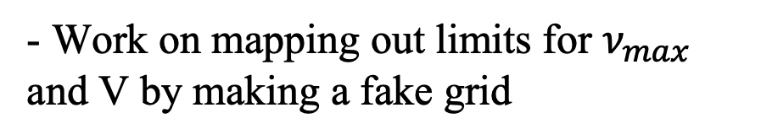
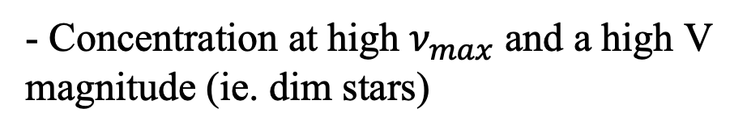
Hand over to DA
- Concentration at high $ν_{max}$ and a high V magnitude (ie. dim stars)
- Work on mapping out limits for $ν_{max}$ and V by making a fake grid
Notes:
→ fake grid: because the population of K dwarfs is naturally sparse in the detection region)
→ overlaying that onto the natural distribution

Slide 24
References
Asteroseismic investigation of known planet hosts in the Kepler field, J. Christensen-Dalsgaard et al,
Solving the Mode Identification Problem in Asteroseismology of F Stars Observed with Kepler Show affiliations, T R. White et al,
Standing on the shoulders of dwarfs: the Kepler Asteroseismic LEGACY Sample. I. Oscillation mode parameters, Lund et al, 2017
Mode lifetimes of stellar oscillations-Implications for asteroseismology, Chaplin et al, 2009
Asteroseismology of solar-type and red-giant stars, Chaplin et al, 2013

Slide 25
Data Analysis

